Slide 1
Cardiovascular system

Slide 2
Main complaints
Chest pain
Palpitation
Dyspnoae, Breathlessness
Syncope/dizziness
Oedema
Cough
Haemoptysis

Slide 3
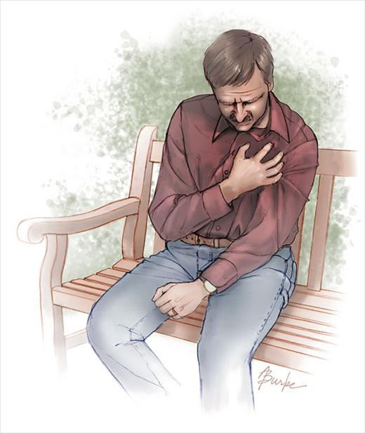
Chest pain
S ite
O nset
C haracter
R adiation
A lleviating factors
T iming
E xacerbating factors
S everity

Slide 4
Typical heart attack pain
Localisation
Character
Irradiation
Intesity
Duration
Condition
Nitrate
retrosternal chest pain
Squeezing, pressing
in the left arm, a brachium, a neck
severe
more than 20 min
arises at an exercise stress, BP↑
doesn't take out

Slide 5
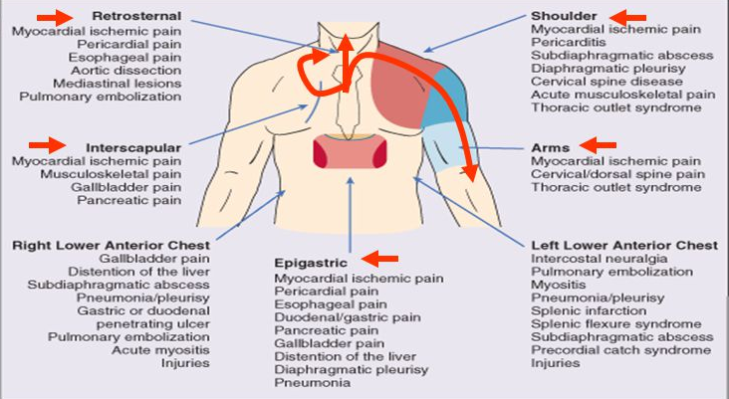

Slide 6
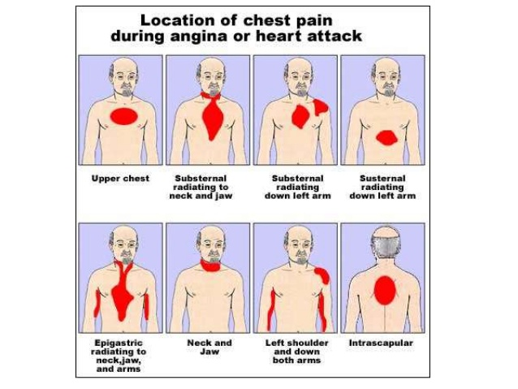

Slide 7
Aterothrombosis – most important mortality condition
AIDS
5.1
Lung diseases
6
Unjury
9.1
Cancer
12.6
Infections
17.8
Aterotrombosis
28.7
0
5
10
15
20
25
30
Moratlity (%)
1. The World Health Report, 2002, WHO Geneva, 2002

Slide 8
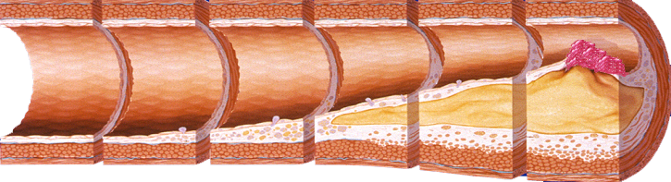
Aterothrombosis - the generalized and progressing process
Non AP
MI
death
ACS
atherosclerosis
Aterothrombosis
Angina pectoralis
Adapted from Stary HC et al. Circulation. 1995; 92: 1355–74, and Fuster V et al. Vasc Med.
1998; 3: 231–9.
Notes:
Atherothrombosis is the common underlying disease process for MI, ischemic stroke, and vascular death.
Acute coronary syndrome (ACS) is a classic example of atherothrombosis (plaque rupture and thrombus formation).
ACS (in common with ischemic stroke and critical leg ischemia) is typically caused by rupture or erosion of an atherosclerotic plaque followed by formation of a platelet-rich thrombus.
Atherosclerosis is an ongoing process affecting mainly large and medium-sized arteries, which can begin in childhood and progress throughout a person’s lifetime.
Stable atherosclerotic plaques may encroach on the lumen of the artery and cause chronic ischemia, resulting in (stable) angina pectoris or intermittent claudication, depending on the vascular bed affected.
Unstable atherosclerotic plaques may rupture, leading to the formation of a platelet-rich thrombus that partially or completely occludes the artery and causes acute ischemic symptoms.
Reference:
1. Drouet L. Cerebrovasc Dis 2002; 13(suppl 1): 1–6.

Slide 9
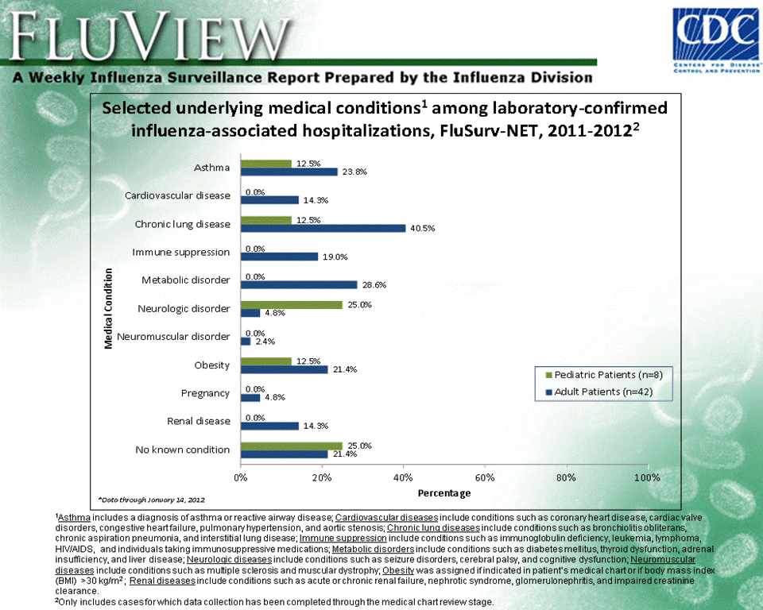

Slide 10
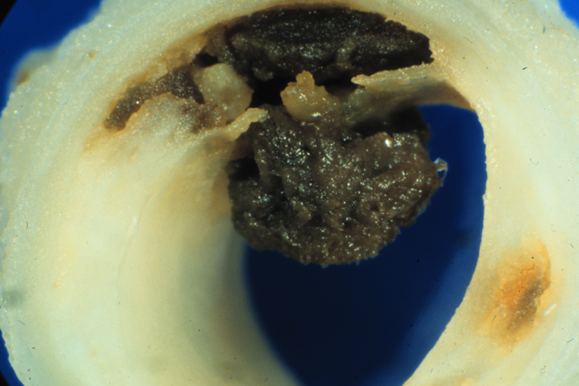

Slide 11
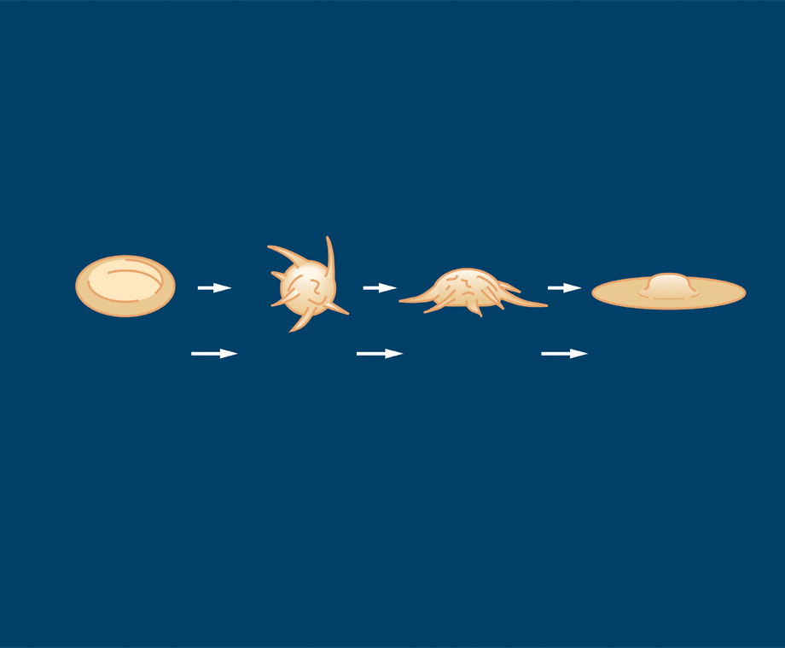
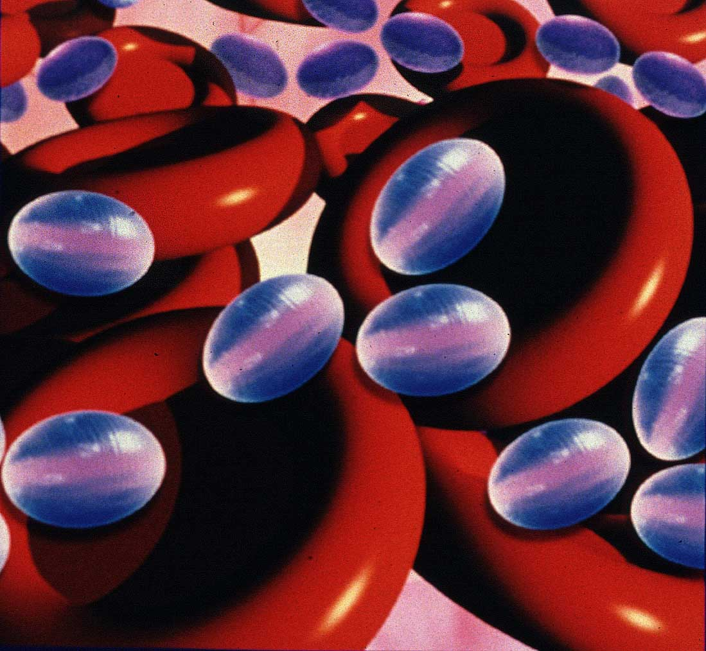
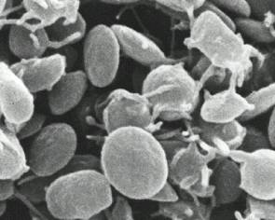
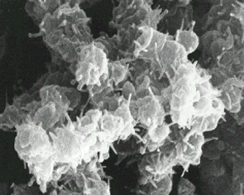
Platelets aggregation
The thrombocyte of a disc form which is going down stream
The rotating thrombocyte of a ball-shaped form
Hemispherical thrombocyte
Fixed thrombocyte
STEADY, BUT
REVERSIBLE ADHESION
Non reversible adhesion
Adapted from: Kuwahara M et al. Arterioscler Thromb Vasc Biol 2002; 22: 329–34.

Slide 12
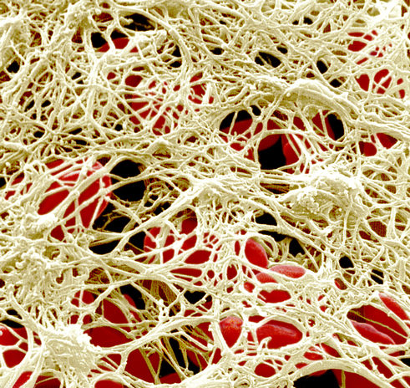
Thrombus
The network forms a thrombus framework round the activated thrombocytes of threads of fibrin

Slide 13
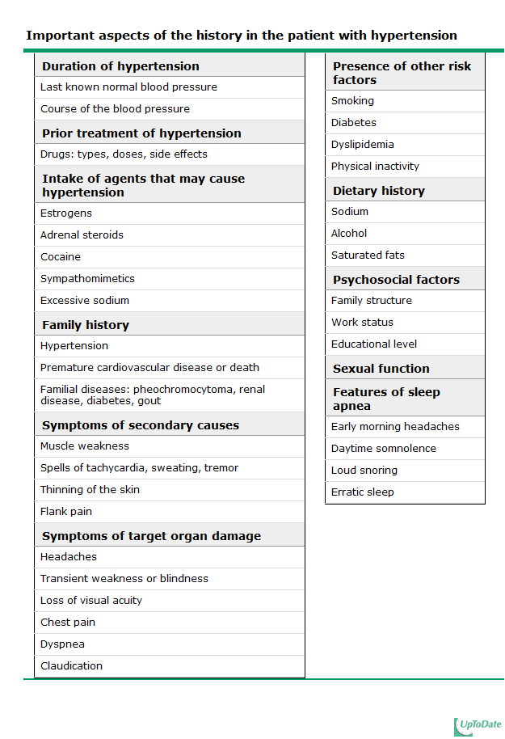

Slide 14
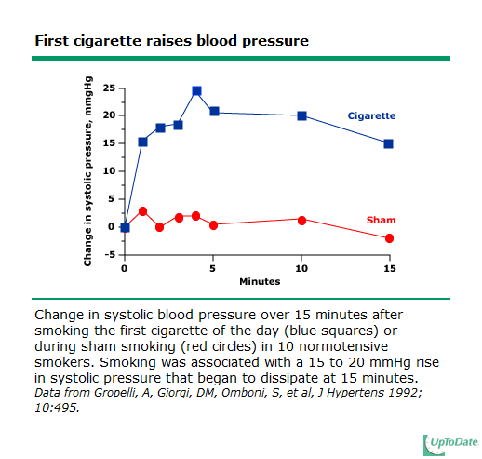

Slide 15
Main risk factors
Nonmodified
Age
Sex
male over 45 years
female: over 55 years
Family history of cardiovascular diseases
Modified
Life style
Smoking, improper feeding, insufficient physical activity, stress
excess body weight > 25 kg/m2
Diabetes mellitus
Dyslipidemia holesterol >6,5 mmol/l
Notes:
Основные факторы, способствующие прогрессированию ССЗ представлены на слайде. И если мы не можем повлиять на так называемые немодифицируемые факторы риска, то в наших силах попытаться изменить ситуацию с такими факторами как артериальная гипертония, нарушения липидного обмена, особенно, поведенческие факторы – курение, неправильное питание, физическая активность.

Slide 16
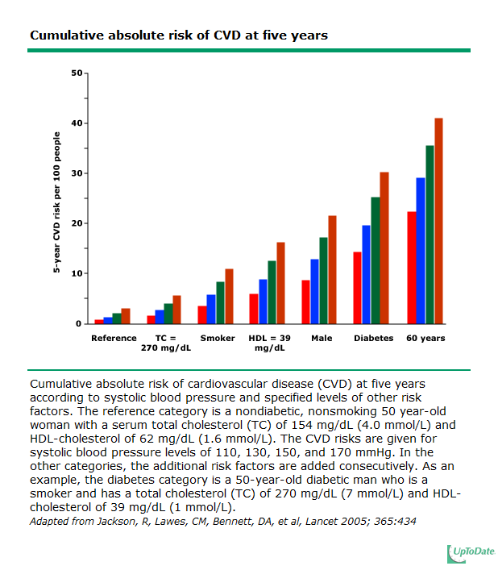

Slide 17
Risk groups stratification
Risk factors
 | High normal | AG 1-st stage | AG 2-st stage | AG 3-st stage
No RF | insignificant | low | moderate | High
1-2 RF | low | moderate | moderate | Very high
≥3 RF CHD | High | High | High | Very high
CVC | Very high | Very high | Very high | Very high
October 8, 2022

Slide 18
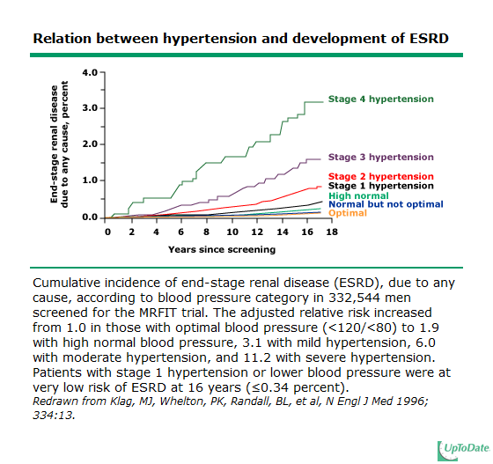

Slide 19
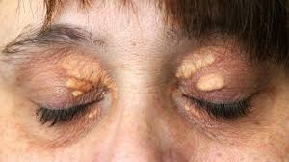
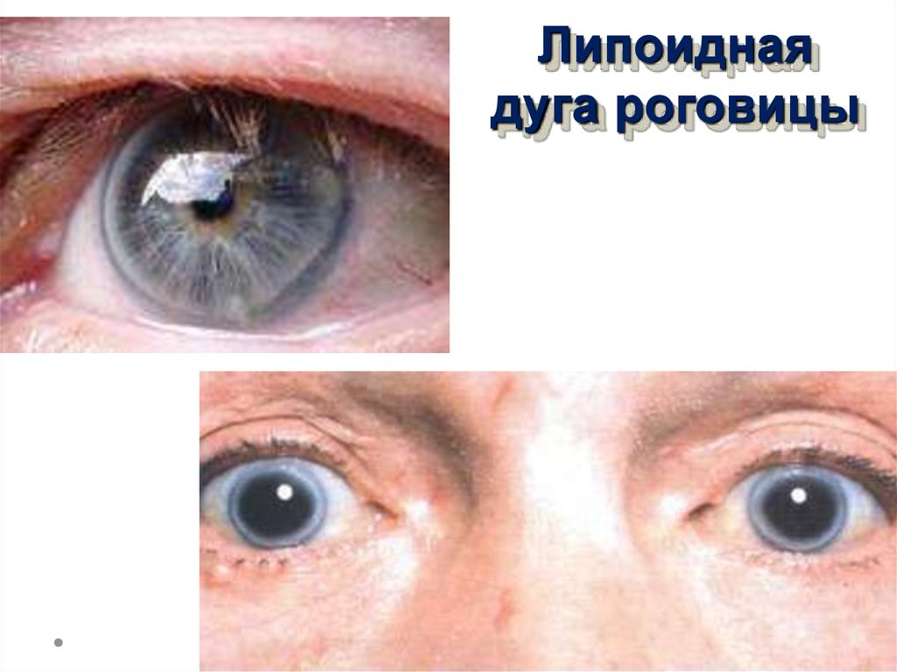
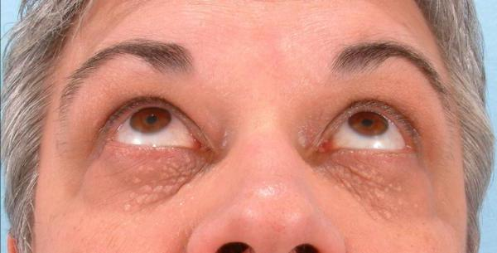
Dyslipidemia

Slide 20
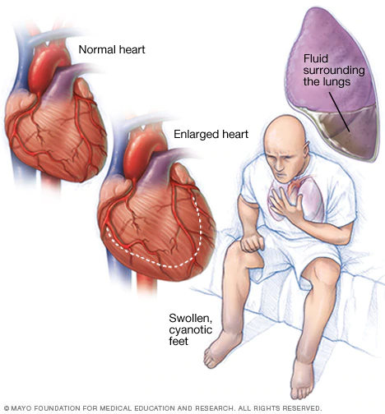
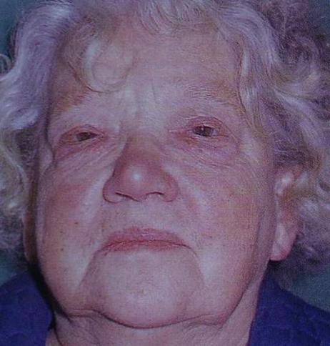
Chronic heart failure facies Corvisart

Slide 21
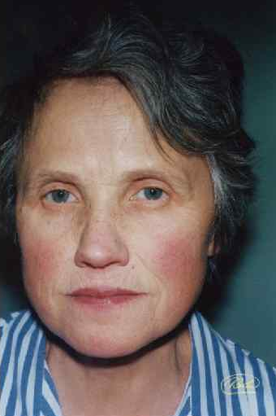
Facies mitrales

Slide 22
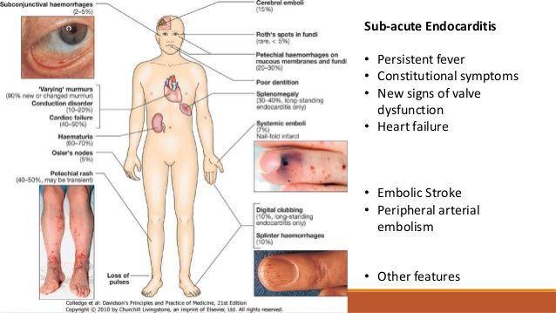

Slide 23
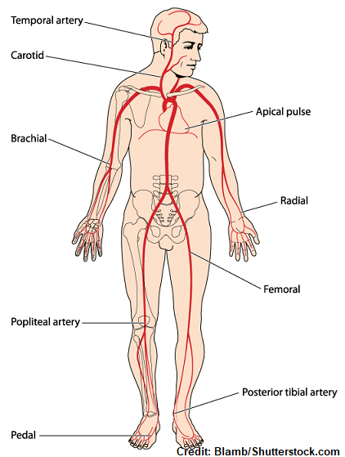
Pulse
Rate
Rhythm
Volume
Character
Simmetry

Slide 24
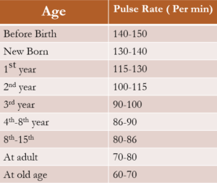

Slide 25
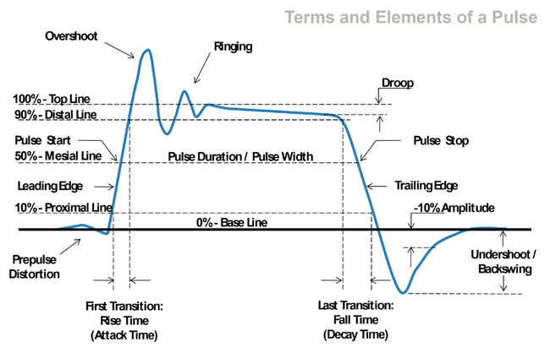

Slide 26
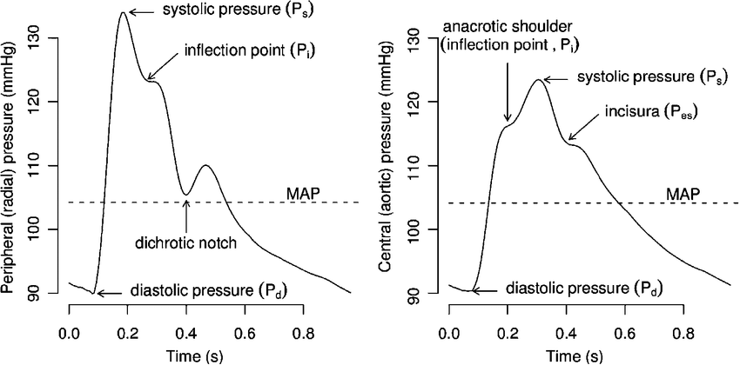

Slide 27
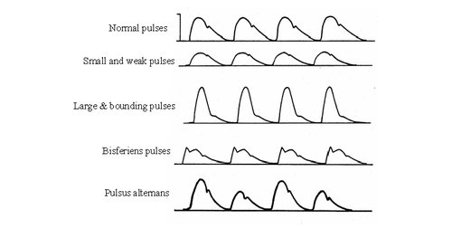

Slide 28
Arterial hypertension
Systolic BP> 140 mm Hg
Diastolic BP> 90 mm Hg
2 measurement with 6 h interval
Or
2 visits in clinic (doctor)

Slide 29
AG classification
WHO 1999
BP | Systolic BP |  | Diastolic BP
Optimal | < 120 | and | < 80
Normal | 120 – 129 | and/or | 80 – 84
High normal | 130 – 139 | and/or | 85 – 89
AG 1-st stage | 140 – 159 | and/or | 90 – 99
AG 2-d stage | 160 – 179 | and/or | 100 – 109
AG 3-d stage | ≥ 180 | and/or | ≥ 110
Isolated systolic AG* | ≥ 140 | and | < 90
Classifed as AG according to systolic BP
October 8, 2022

Slide 30
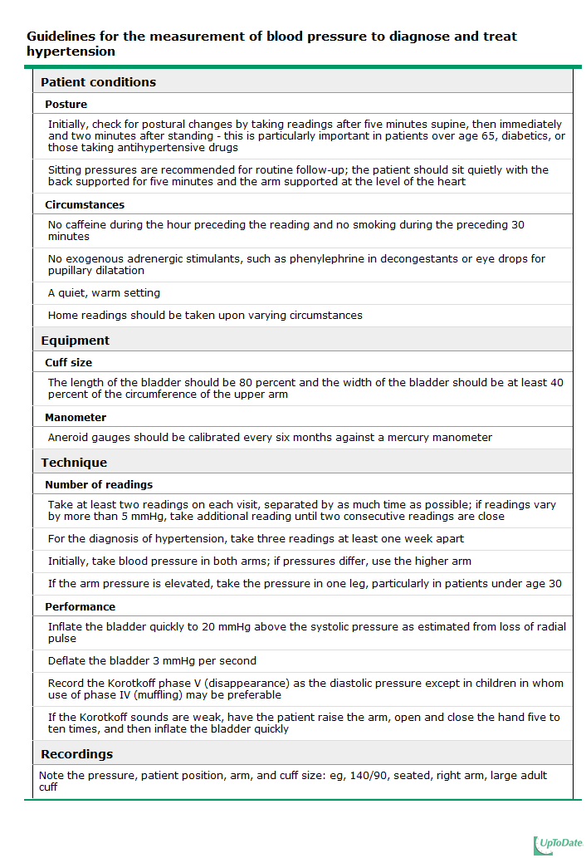

Slide 32
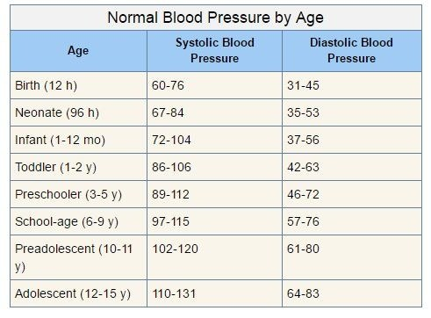

Slide 33
https://vk.com/video-94804410_456247247
https://youtu.be/G4dFVeP9Vdo

Slide 34
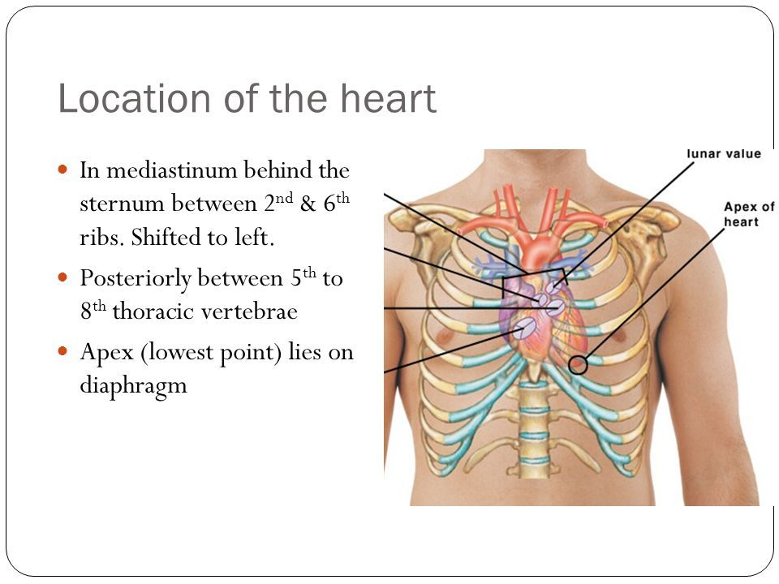
Palpation – apex beat

Slide 35
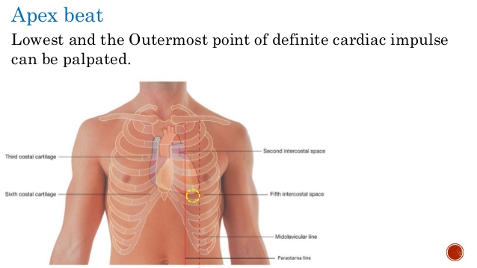

Slide 36
Apex beat
Location – replaced or not?
Square or size – normal 2 sm – diffuse
Height -
Forceful or weak
Resistance

Slide 37
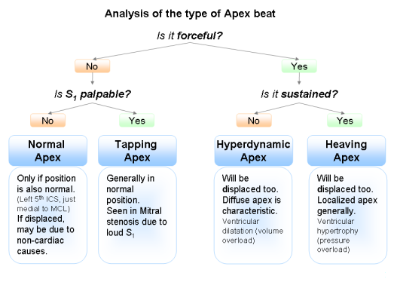

Slide 38
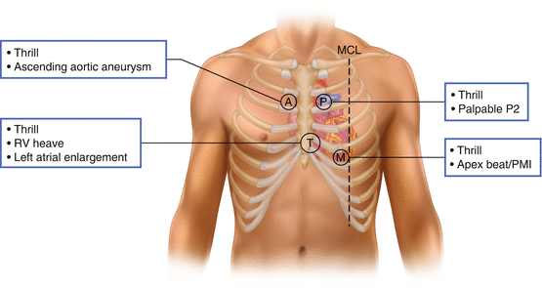

Slide 39
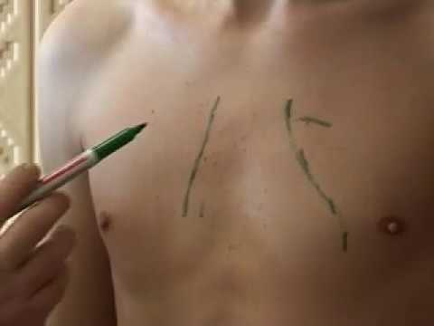
Percussion – relative dullness of the heart
 | Line for percussion | Normal
Right border | IV intercostal space | 0-1 sm lateral then right edge of the strernum
Left border | V intercostal space | 1-2 sm medial then left mediaclavicular line (match with apex beat)
Upper border | 1 sm lateral then Left sternal line | III left rib
heart - diameter - 11-13 sm vascular bundle width – 5-6 sm (II intercostal space)

Slide 40
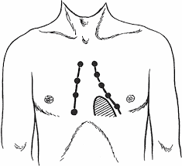
Percussion – absolute of the heart
 | Line for percussion | Normal
Right border | IV intercostal space | 1-2 sm lateral then right border of relative dullness
Left border | V intercostal space | 1-2 sm medial then right border of relative dullness
Upper border | 1 sm lateral then Left sternal line | IV left rib

Slide 41
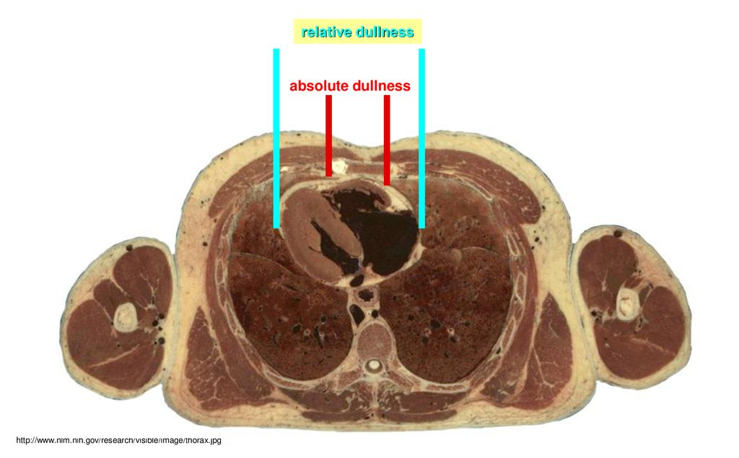

Slide 42
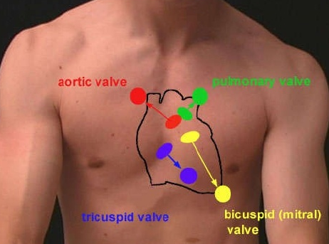
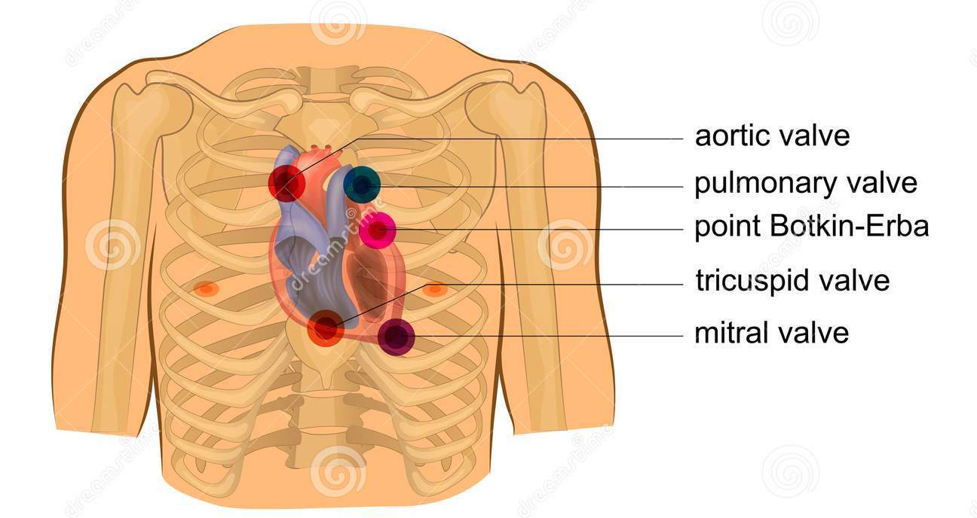
Auscultation – points

Slide 43
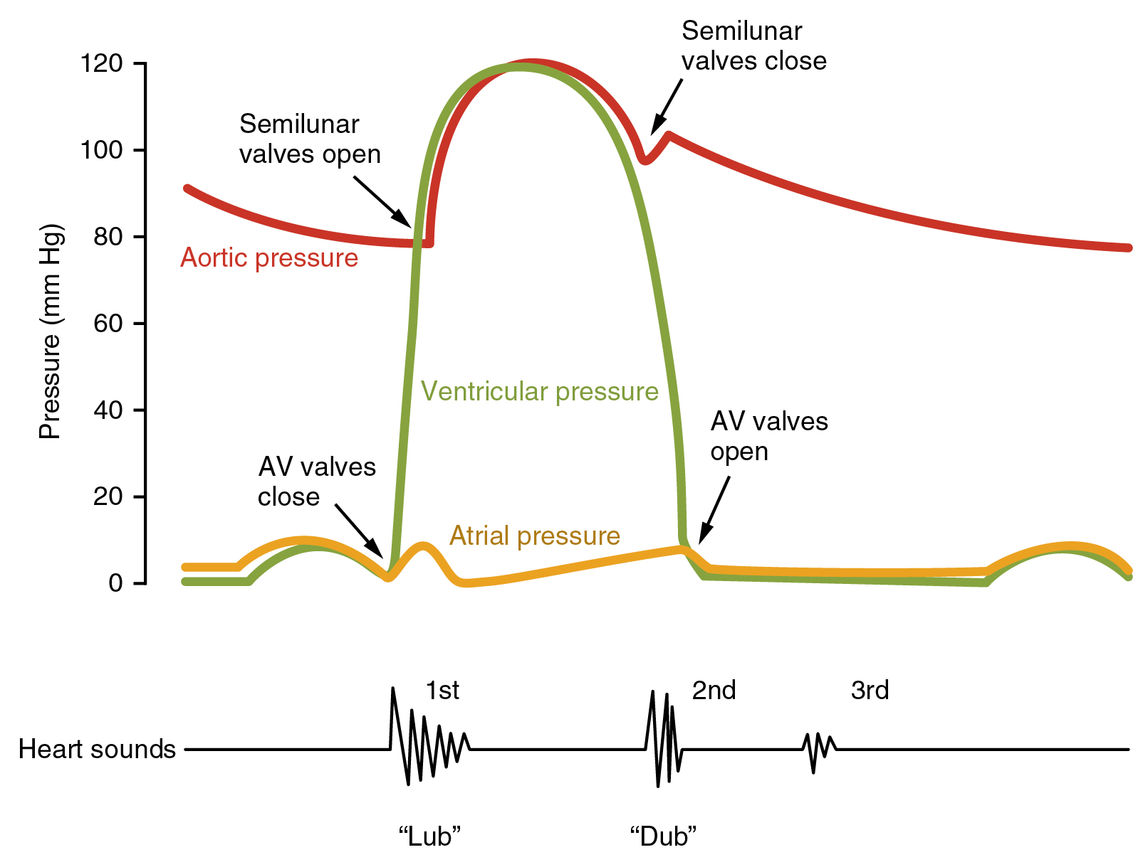

Slide 44
1 systolic tone
Valve component – closure of the mitral and tricuspid valves
Myocardial component - thrilling of heart wall
Vascular component
Chord component

Slide 45
2 diastolic tone
Valve component - closure of the pulmonary and aortic valves
Vascular component

Slide 46
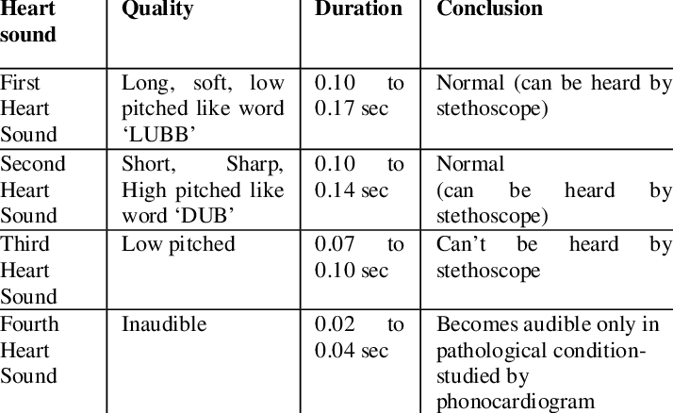

Slide 47
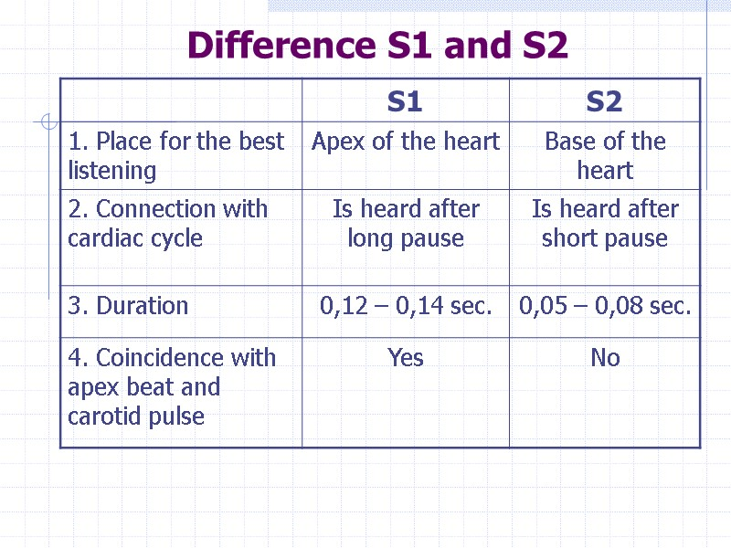

Slide 48
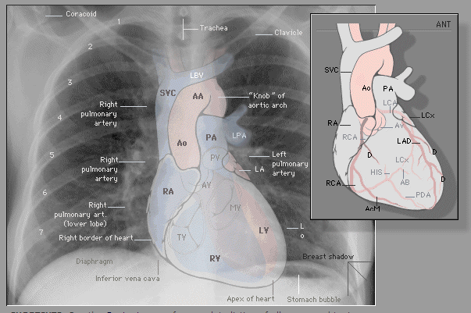

Slide 49
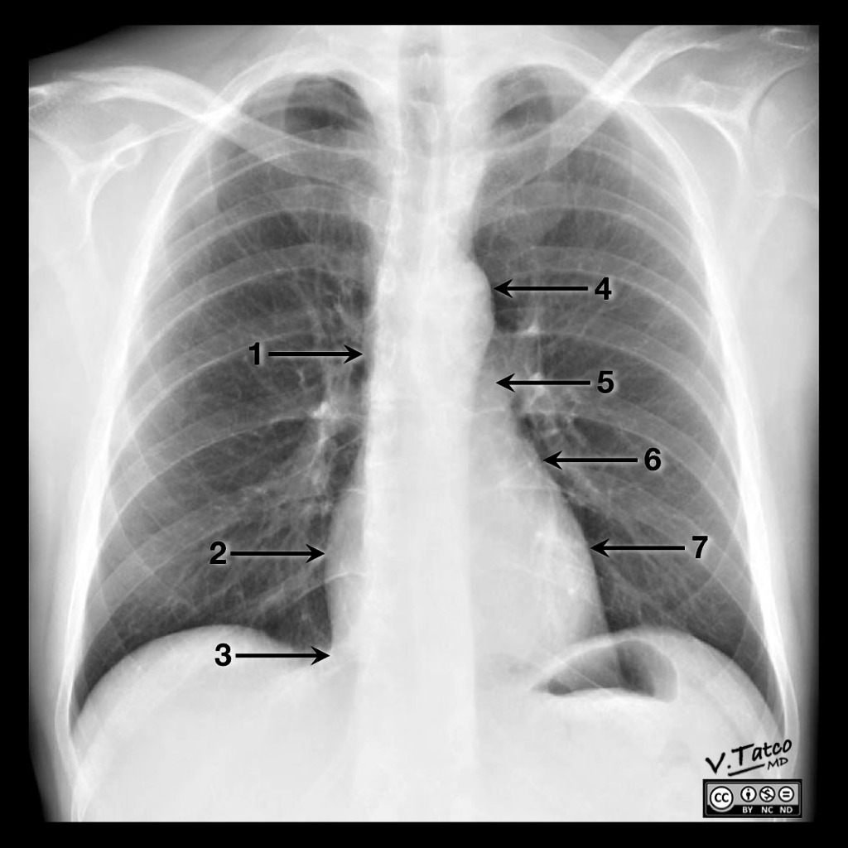

Slide 50
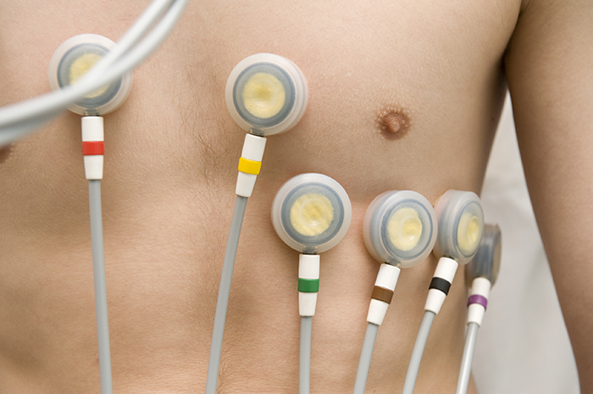

Slide 51
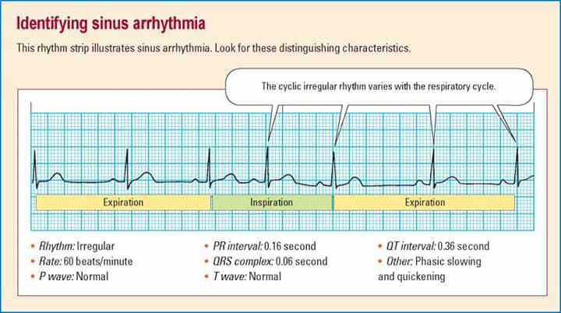

Slide 52
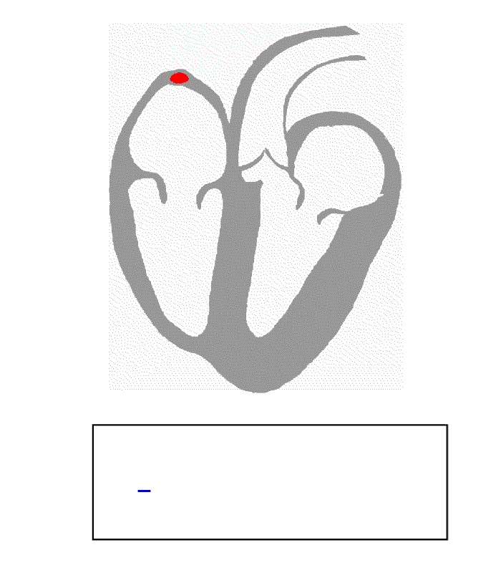

Slide 53


Slide 54
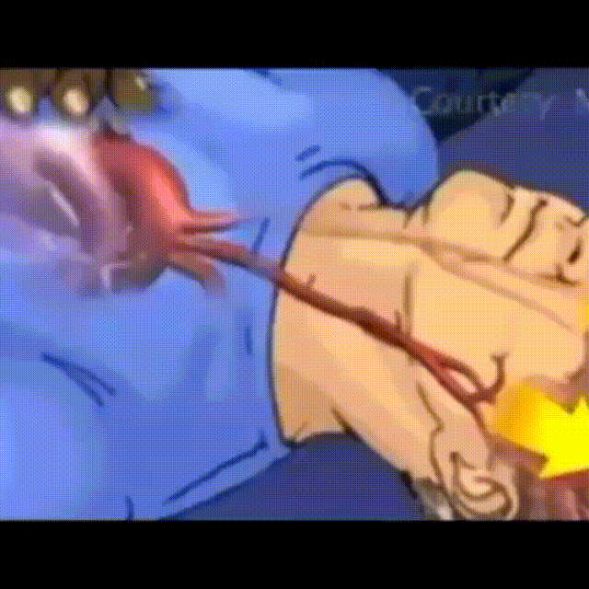

Slide 55


